Slide 1
SSZG518: Database design and Applications Ms. Uma Maheswari

Slide 2
Session 10 TRANSACTIONS

Slide 3
LEARNING OUTCOME
Introduction to transactions
States of a transaction
Desirable properties of a transaction
Schedules
Concurrent transactions
Serializability
REFER: T1-Chapter 17
Sections: 17.1- 17.6

Slide 4
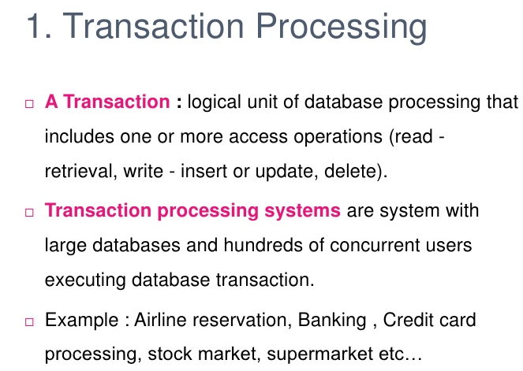
Introduction to transactions
Examples of transactions:
deposit the amount of $N into account A
Transfer the amount of $N from account A to account B
Close (= delete) the account A

Slide 5
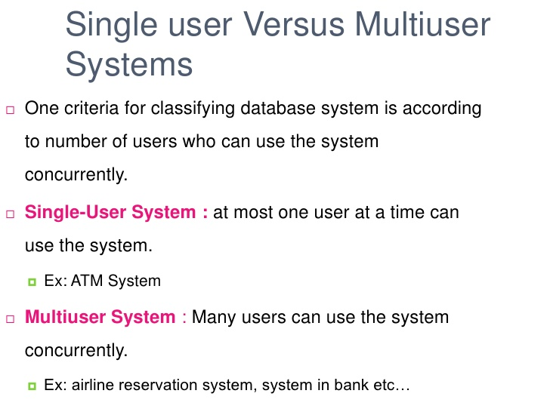
Introduction to transactions

Slide 6
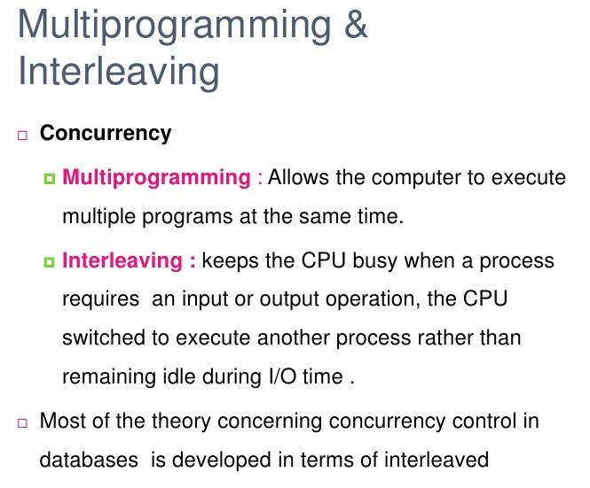
NATURE OF PROCESSING

Slide 7
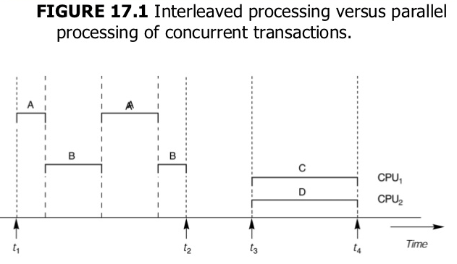
Introduction to transactions

Slide 8
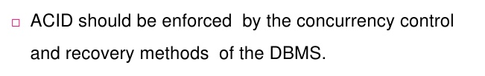
Properties of a transaction ACID
Atomicity: A transaction is an atomic unit of data processing . Ie., a transaction is either performed in its entirety
or not performed at all.
Consistency perservation: A transaction is consistency preserving if its complete execution takes the database
from one consistent state to another consistent state.
Isolation: Although transactions are executed concurrently, each transaction should appear as though it is being
executed in isolation from other transactions. Ie., The execution of a transaction should not be interfered with by
other transactions executing at the same time
Durability : or permanency The changes made to the database by a comitted (= successful) transaction must persist in the database. Ie., The changes must not be lost because of possible failure occuring immediately after the transaction

Slide 9
Transactions terminology:
Transaction = a block of operations between begin_transaction and end_transaction
Commit = a successful termination of a transaction. Ie. The operations of a comitted transaction is guaranteed
to be performed on the data in the database
Abort = an unsuccessful termination of a transaction ie., The operations of an aborted transaction is guaranteed
not to be performed on the data in the database
Roll back = the process of undoing the updates made by the operations of a transaction
Redo = the process of performing the updates made by the operations of a transaction again
A transaction cannot be executed partially
So you cannot perform only some operations of a transaction while not performing others !!!

Slide 10
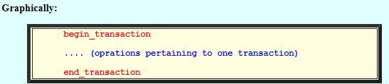
Denoting transaction and examples
keywords begin_transaction and end_transaction to delimit the operations that pertain to one transaction
Transaction ID
To implement transaction processing , each transaction is assigned a unique transaction ID
The transaction ID is used to identify the operations that a particular transaction has performed on the database
The operations that are defined on a data item are:
read_item(X): read the data item named X write_item(X): write the data item named X

Slide 11

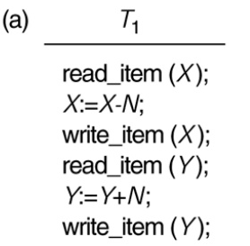
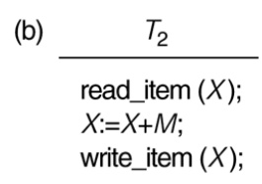
transaction examples

Slide 12
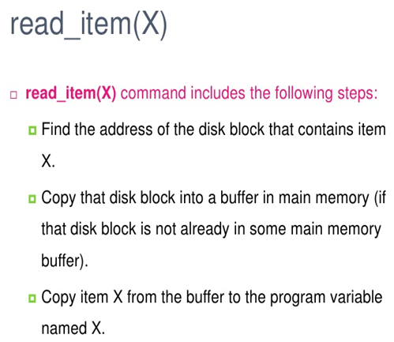
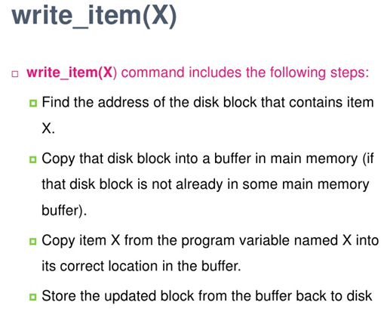
Operations on data item :

Slide 13
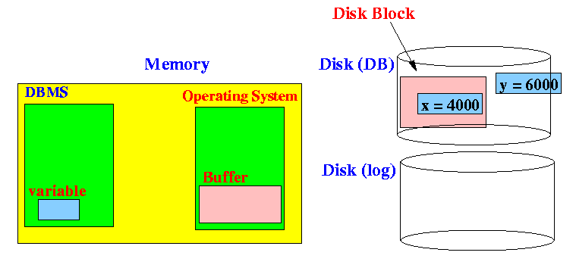
What happens in the read_item(x) operation:
1. Locate the disk block that contains the data item x:

Slide 14
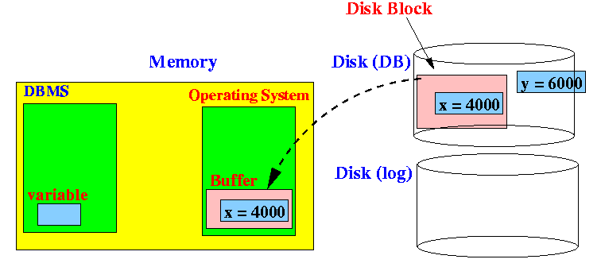
What happens in the read_item(x) operation:
2. Read (copy) the disk block that contains the data item x into a system buffer (inside the Operating System):
(In other words: the entire disk block is read in (not just the data item x !!!)

Slide 15
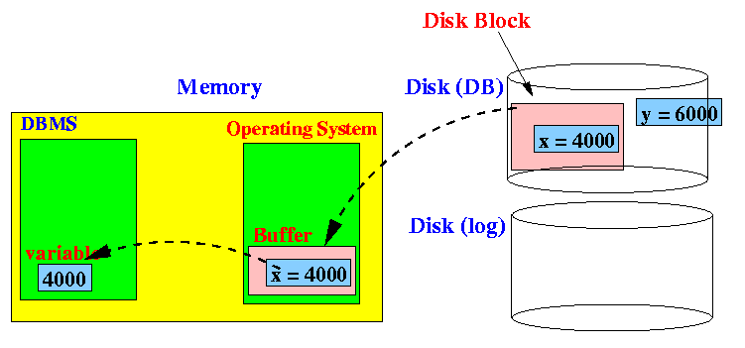
What happens in the read_item(x) operation:
3. Read (copy) the data item x from the Operating System buffer into a program variable inside the DBMS:

Slide 16
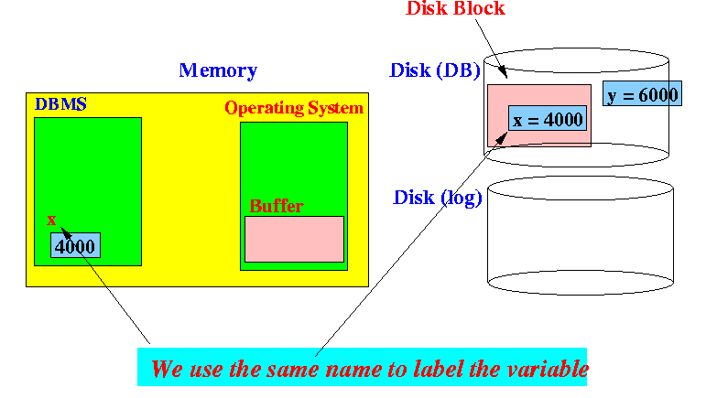
What happens in the read_item(x) operation:
We will also need a name to refer to the variable that holds the data item inside the main memory
For convenience, we will use the name of the data item for the data inside the buffer:
From the context, it should be clear
which of the data is referred to by the
name x

Slide 17
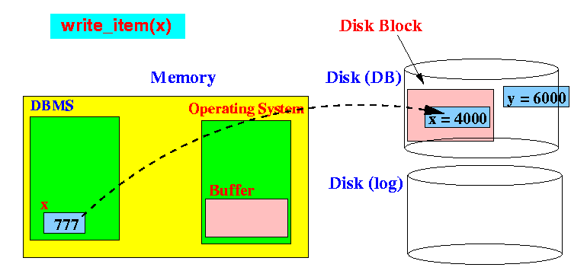
What happens in the write_item(x) operation:
First, note that the DBMS variable x will be used to update the data item x in the database.
Example:
The x in write_item(x) refers to the memory variable x (with value 777) !!!

Slide 18
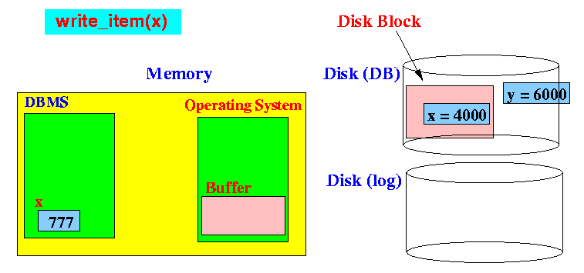
What happens in the write_item(x) operation:
Locate the disk block that contains the data item x:

Slide 19
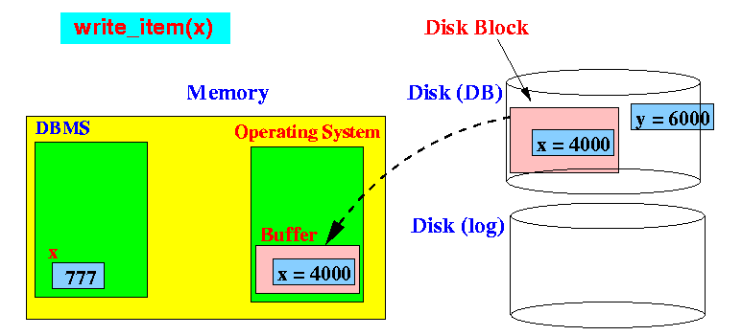
What happens in the write_item(x) operation:
Read (copy) the disk block that contains the data item x into a system buffer (inside the Operating System):
Note: if the disk block has been previously read in and it is still available inside the Operating System buffers, then this step is skipped !

Slide 20
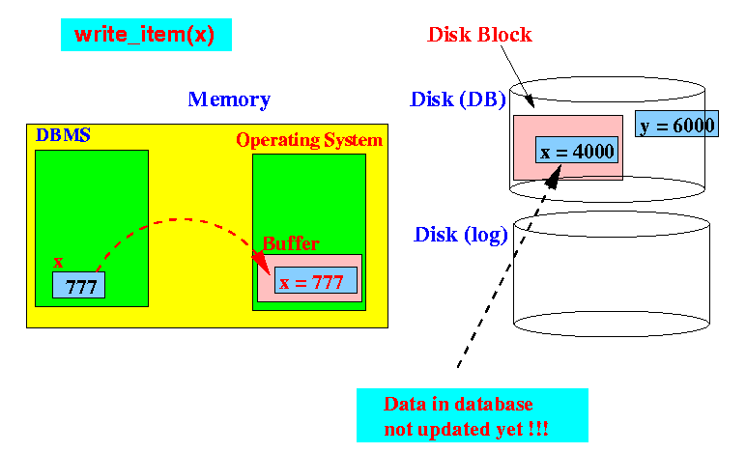
What happens in the write_item(x) operation:
Write (copy) the value:
Note: the data item x inside the data base has not been updated yet !!!

Slide 21
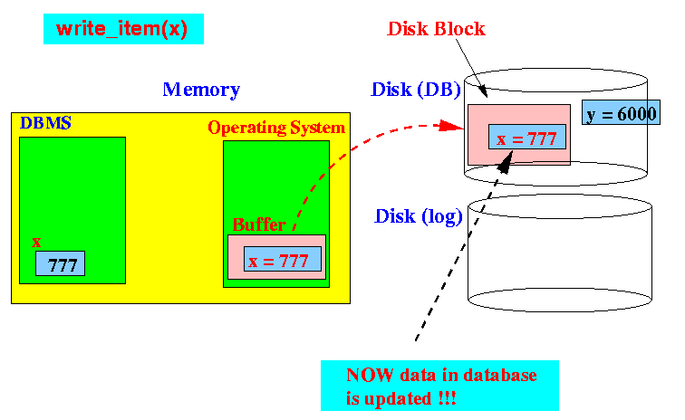
What happens in the write_item(x) operation:
Write (copy) the disk block to disk:
Note: now the data item x is updated !!

Slide 22
Timing of writes in transactions
Timing of issueing/executing a write operation:
There are 2 commonly used moments to issue write operations:
1. Immediately (as soon as the memory veriable is updated, the change is written to the data in the database)
Ie., The rationale for this choice is the fact that we want to make the new value available to other transactions as
soon as possible.
2. At the end of the transaction The rationale for this choice is the fact that the same variable may be updated
multiple times within one transaction. This scheme will be more efficient.
In place (or immediate) write: In place (or immediate) write = a write operation to the database is issued as soon as
a memory variable is updated.
Deferred write = all write operations to the database are issued at the end of the transaction.

Slide 23
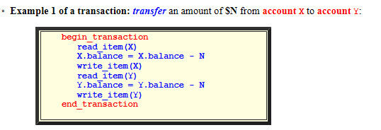
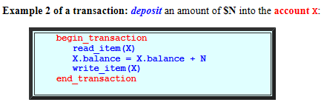

Slide 24
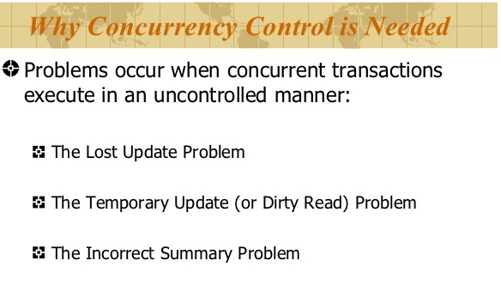
Concurrency Control
A database system is used concurrently by multiple users ie., Multiple transactions are processed concurrently
Either of these situations will cause inconsistency in the database system

Slide 25
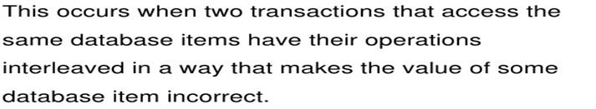
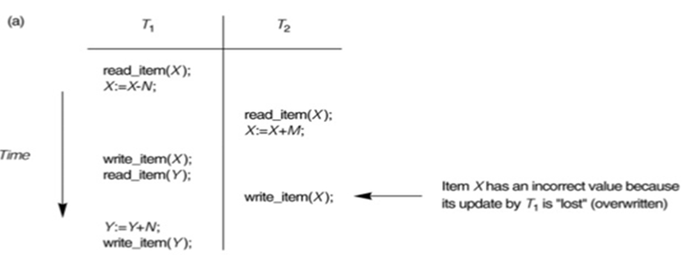
Concurrency Control
LOST UPDATE PROBLEM

Slide 26
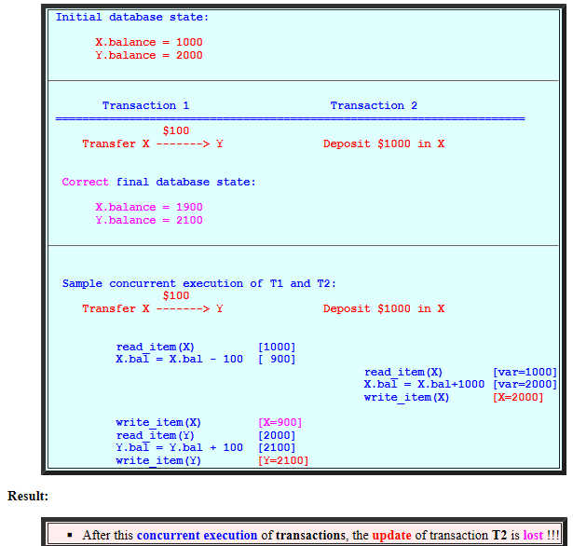
Concurrency Control
LOST UPDATE PROBLEM
An update is lost if after executing a transaction, the result of the transaction is not reflected in the final database state

Slide 27
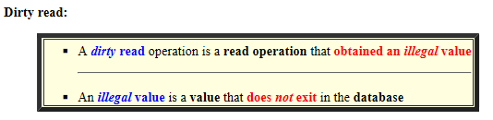
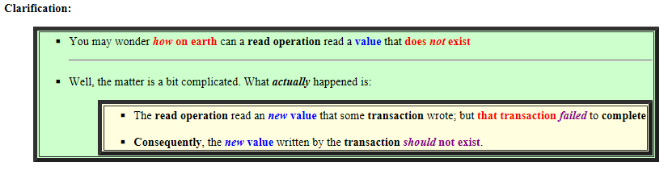
Concurrency Control
Temporary Update (or Dirty read)

Slide 28
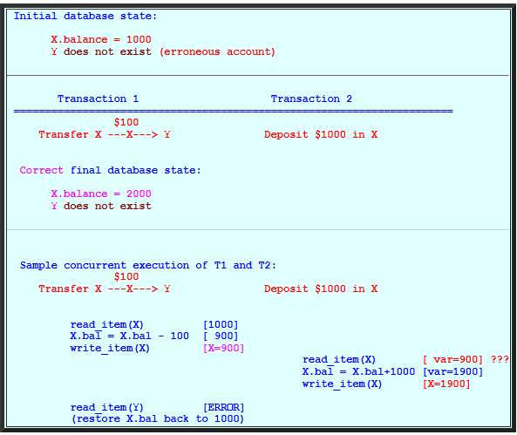
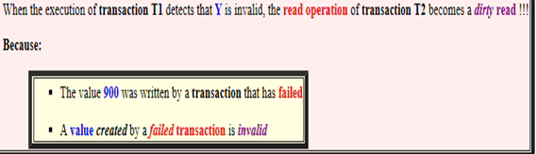
Concurrency Control
Temporary Update (or Dirty read)

Slide 29
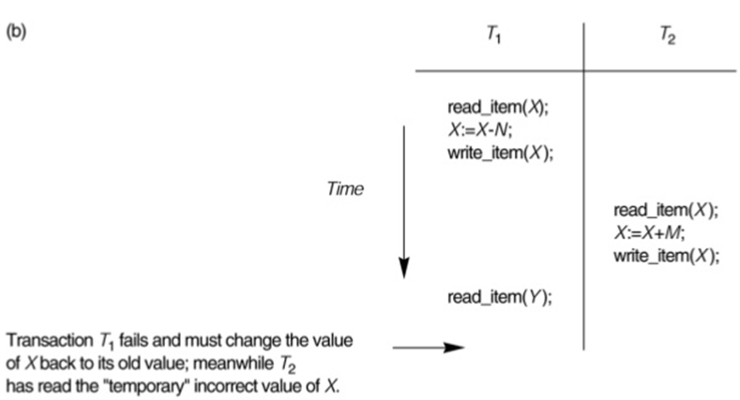
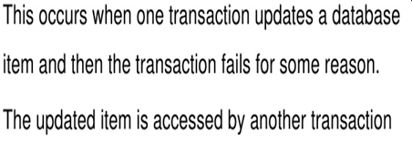
Concurrency Control
Temporary Update (or Dirty read)

Slide 30
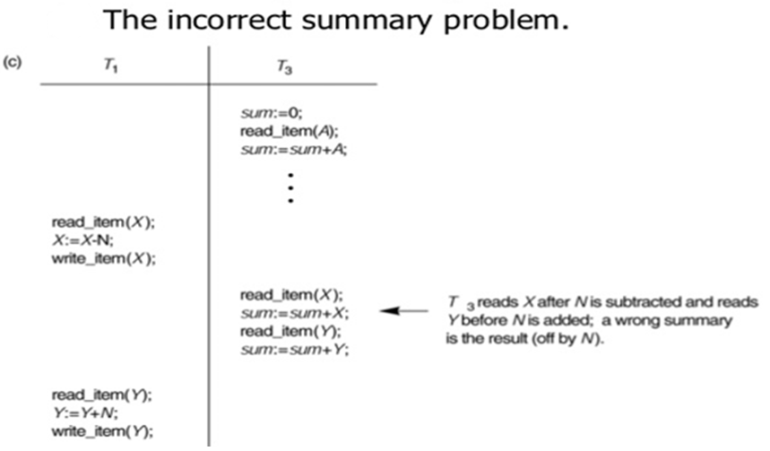
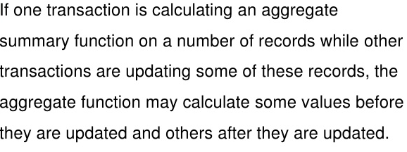
Concurrency Control
Incorrect summary problem

Slide 31
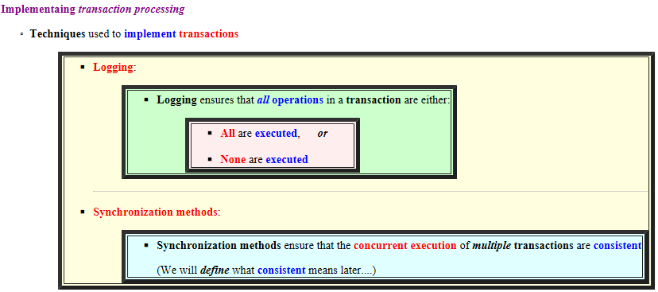
Transaction processing (TP)

Slide 32
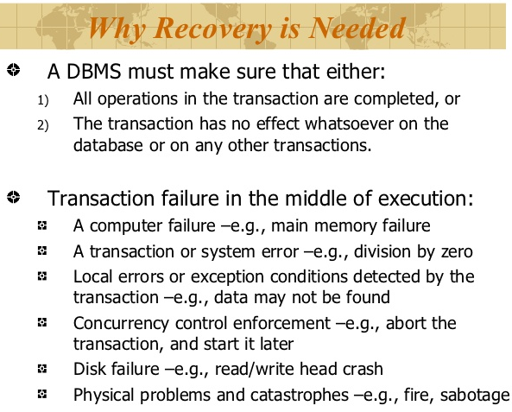
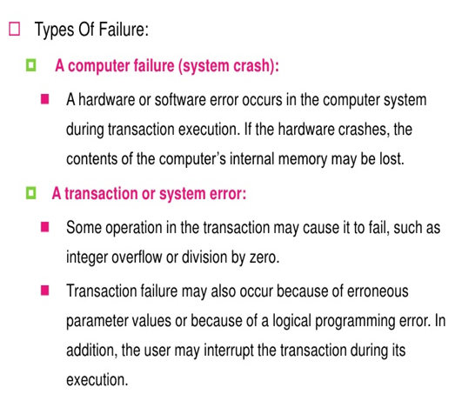
Recovery

Slide 33
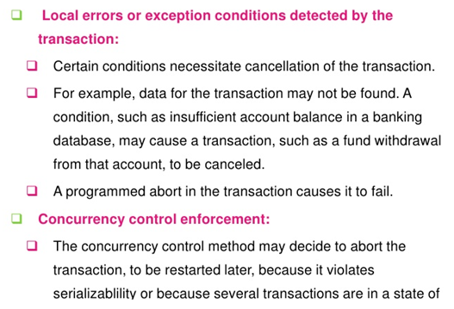
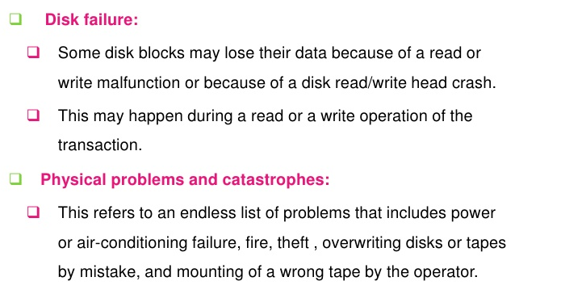
Recovery

Slide 34
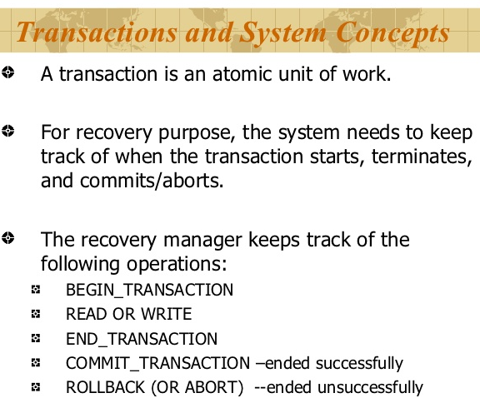
Transaction

Slide 35
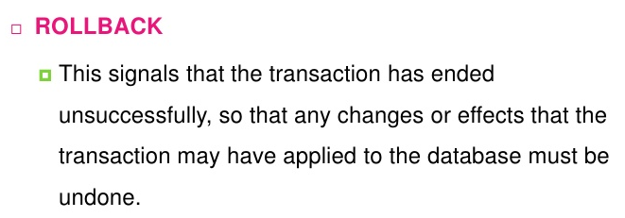
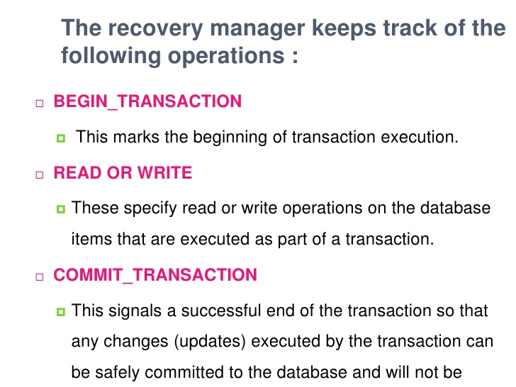
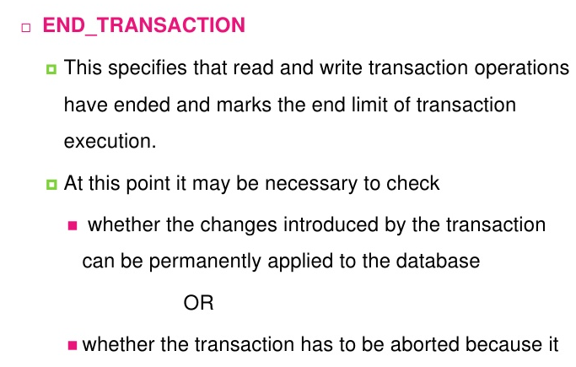
Transaction
Lost.
Encountered err.

Slide 36
EXAMPLE OF TRANSACTION
Example of Fund Transfer
Transaction to transfer $1000 from account X to account Y:
read(X)
X = X –1000
write(X)
read(Y)
Y = Y + 1000
write(Y)
Atomicity requirement — if the transaction fails after step 3 and before step 6, the system should ensure that its updates are not reflected in the database, else an inconsistency will result.
Consistency requirement – the sum of X and Y is unchanged by the execution of the transaction.
if between steps 3 and 6, another transaction is allowed to access the partially updated database, it will see an inconsistent database (the sum X + Y will be less than it should be).
Isolation can be ensured trivially by running transactions serially, that is one after the other.
However, executing multiple transactions concurrently has significant benefits, as we will see later.
Durability requirement — once the user has been notified that the transaction has completed (i.e., the transfer of the $1000 has taken place), the updates to the database by the transaction must persist despite failures.

Slide 37
MYSQL and MS SQLSERVER
MYSQL
SELECT * FROM account;
START TRANSACTION;
UPDATE account
SET bal = bal - 1000
WHERE acno = 155 AND bal >1000;
UPDATE account
SET bal = bal + 1000
WHERE acno = 200;
COMMIT;
SELECT * FROM account;
Output:
acno 1
bal
155 -1000
200 6000

Slide 38
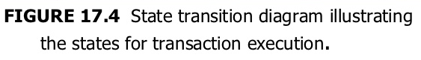
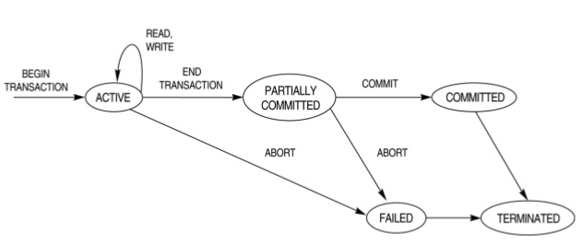
States of Transaction

Slide 39
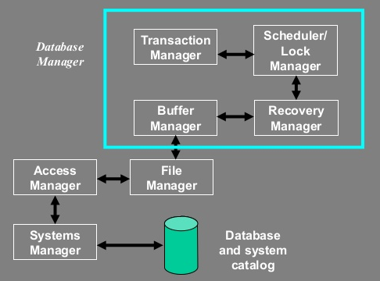
Transaction subsystem

Slide 40
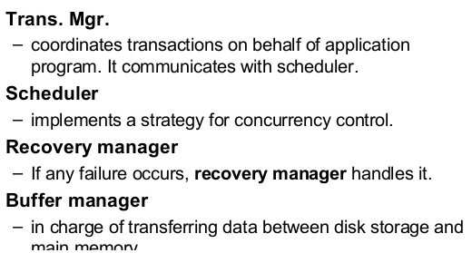
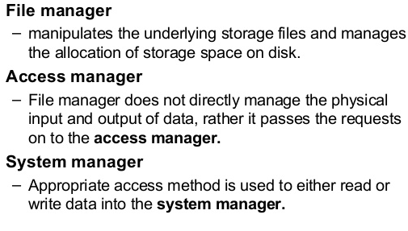
Transaction subsystem

Slide 41
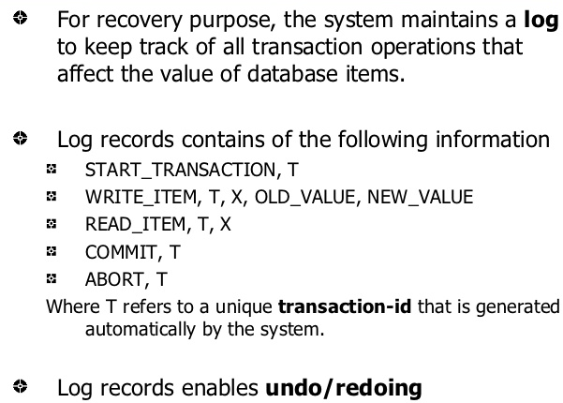
Transaction

Slide 42
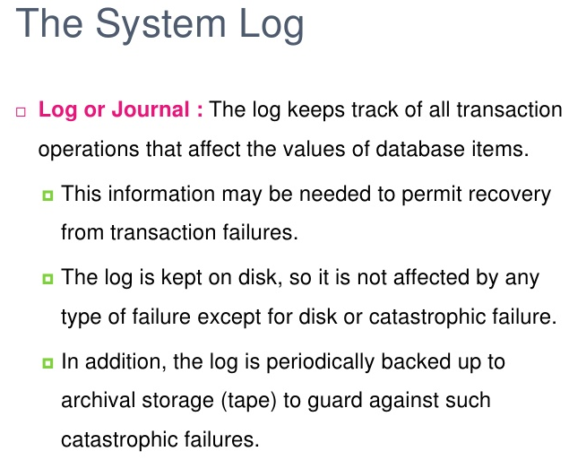
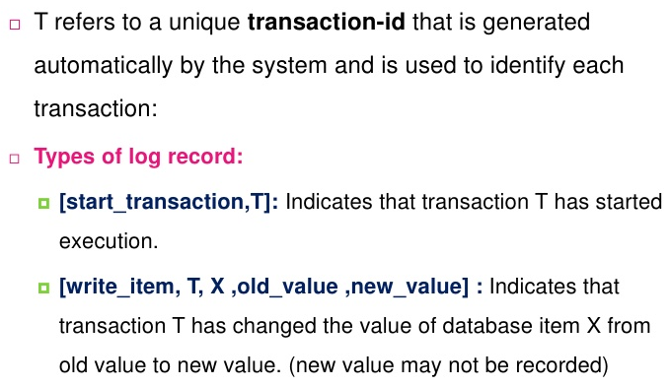
Transaction

Slide 43

Transaction

Slide 44


Transaction

Slide 45


Transaction Log

Slide 46


Transaction

Slide 47



ACID Properties

Slide 48


Concurrency

Slide 49

Concurrency

Slide 50


Transaction and schedule

Slide 51



Anomalies with interleaved Execution

Slide 52


Conflict Schedule

Slide 53

Transaction and schedule

Slide 54

Transaction and schedule

Slide 55

Transaction and schedule

Slide 56

Transaction and schedule

Slide 57

Transaction and schedule

Slide 58



SERIAL SCHEDULES

Slide 59


Serial vs Non Serial Schedules

Slide 60


Transaction and schedule

Slide 61


Slide 62


Slide 63



Serializable Schedule

Slide 64


Slide 65


Slide 66


Slide 67


Slide 68



Slide 69




Slide 70


Slide 71
THANK YOU

